Slide 1
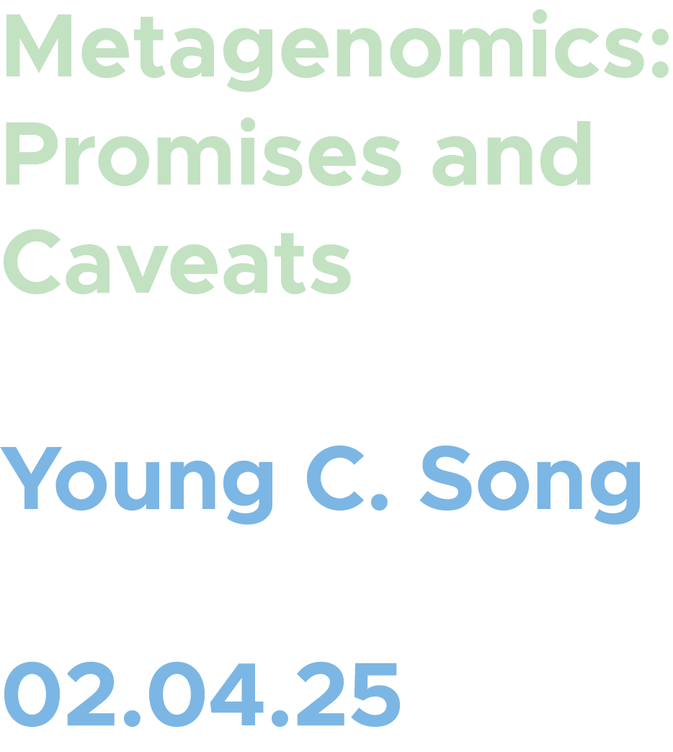

Slide 2
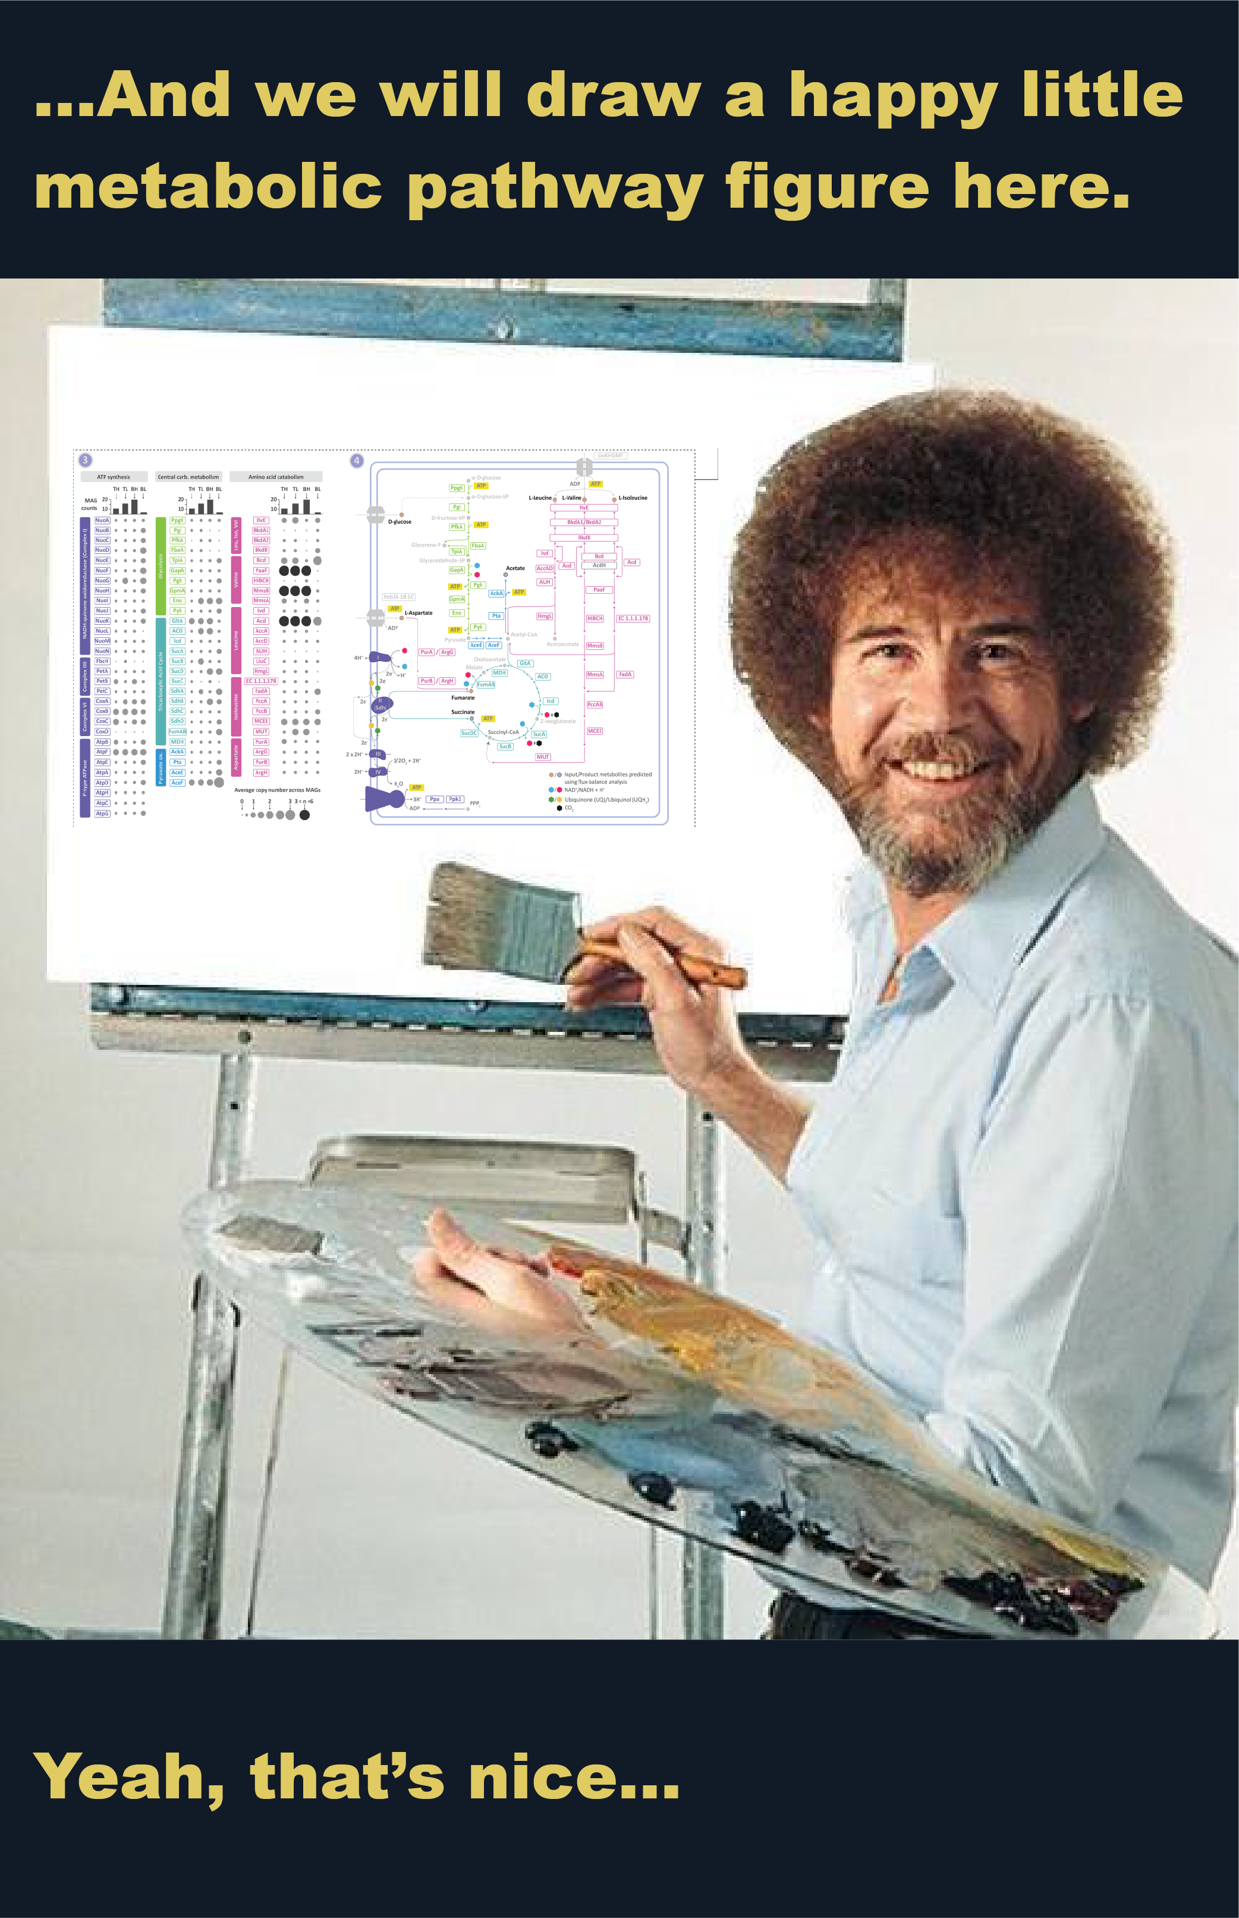

What is metagenomics (and why)?
Limitations in metagenomics
Data from JGI pipeline
Types of analyses/questions addressed with some of the JGI data
Alternate solutions available at the DOE (KBase)

Slide 3
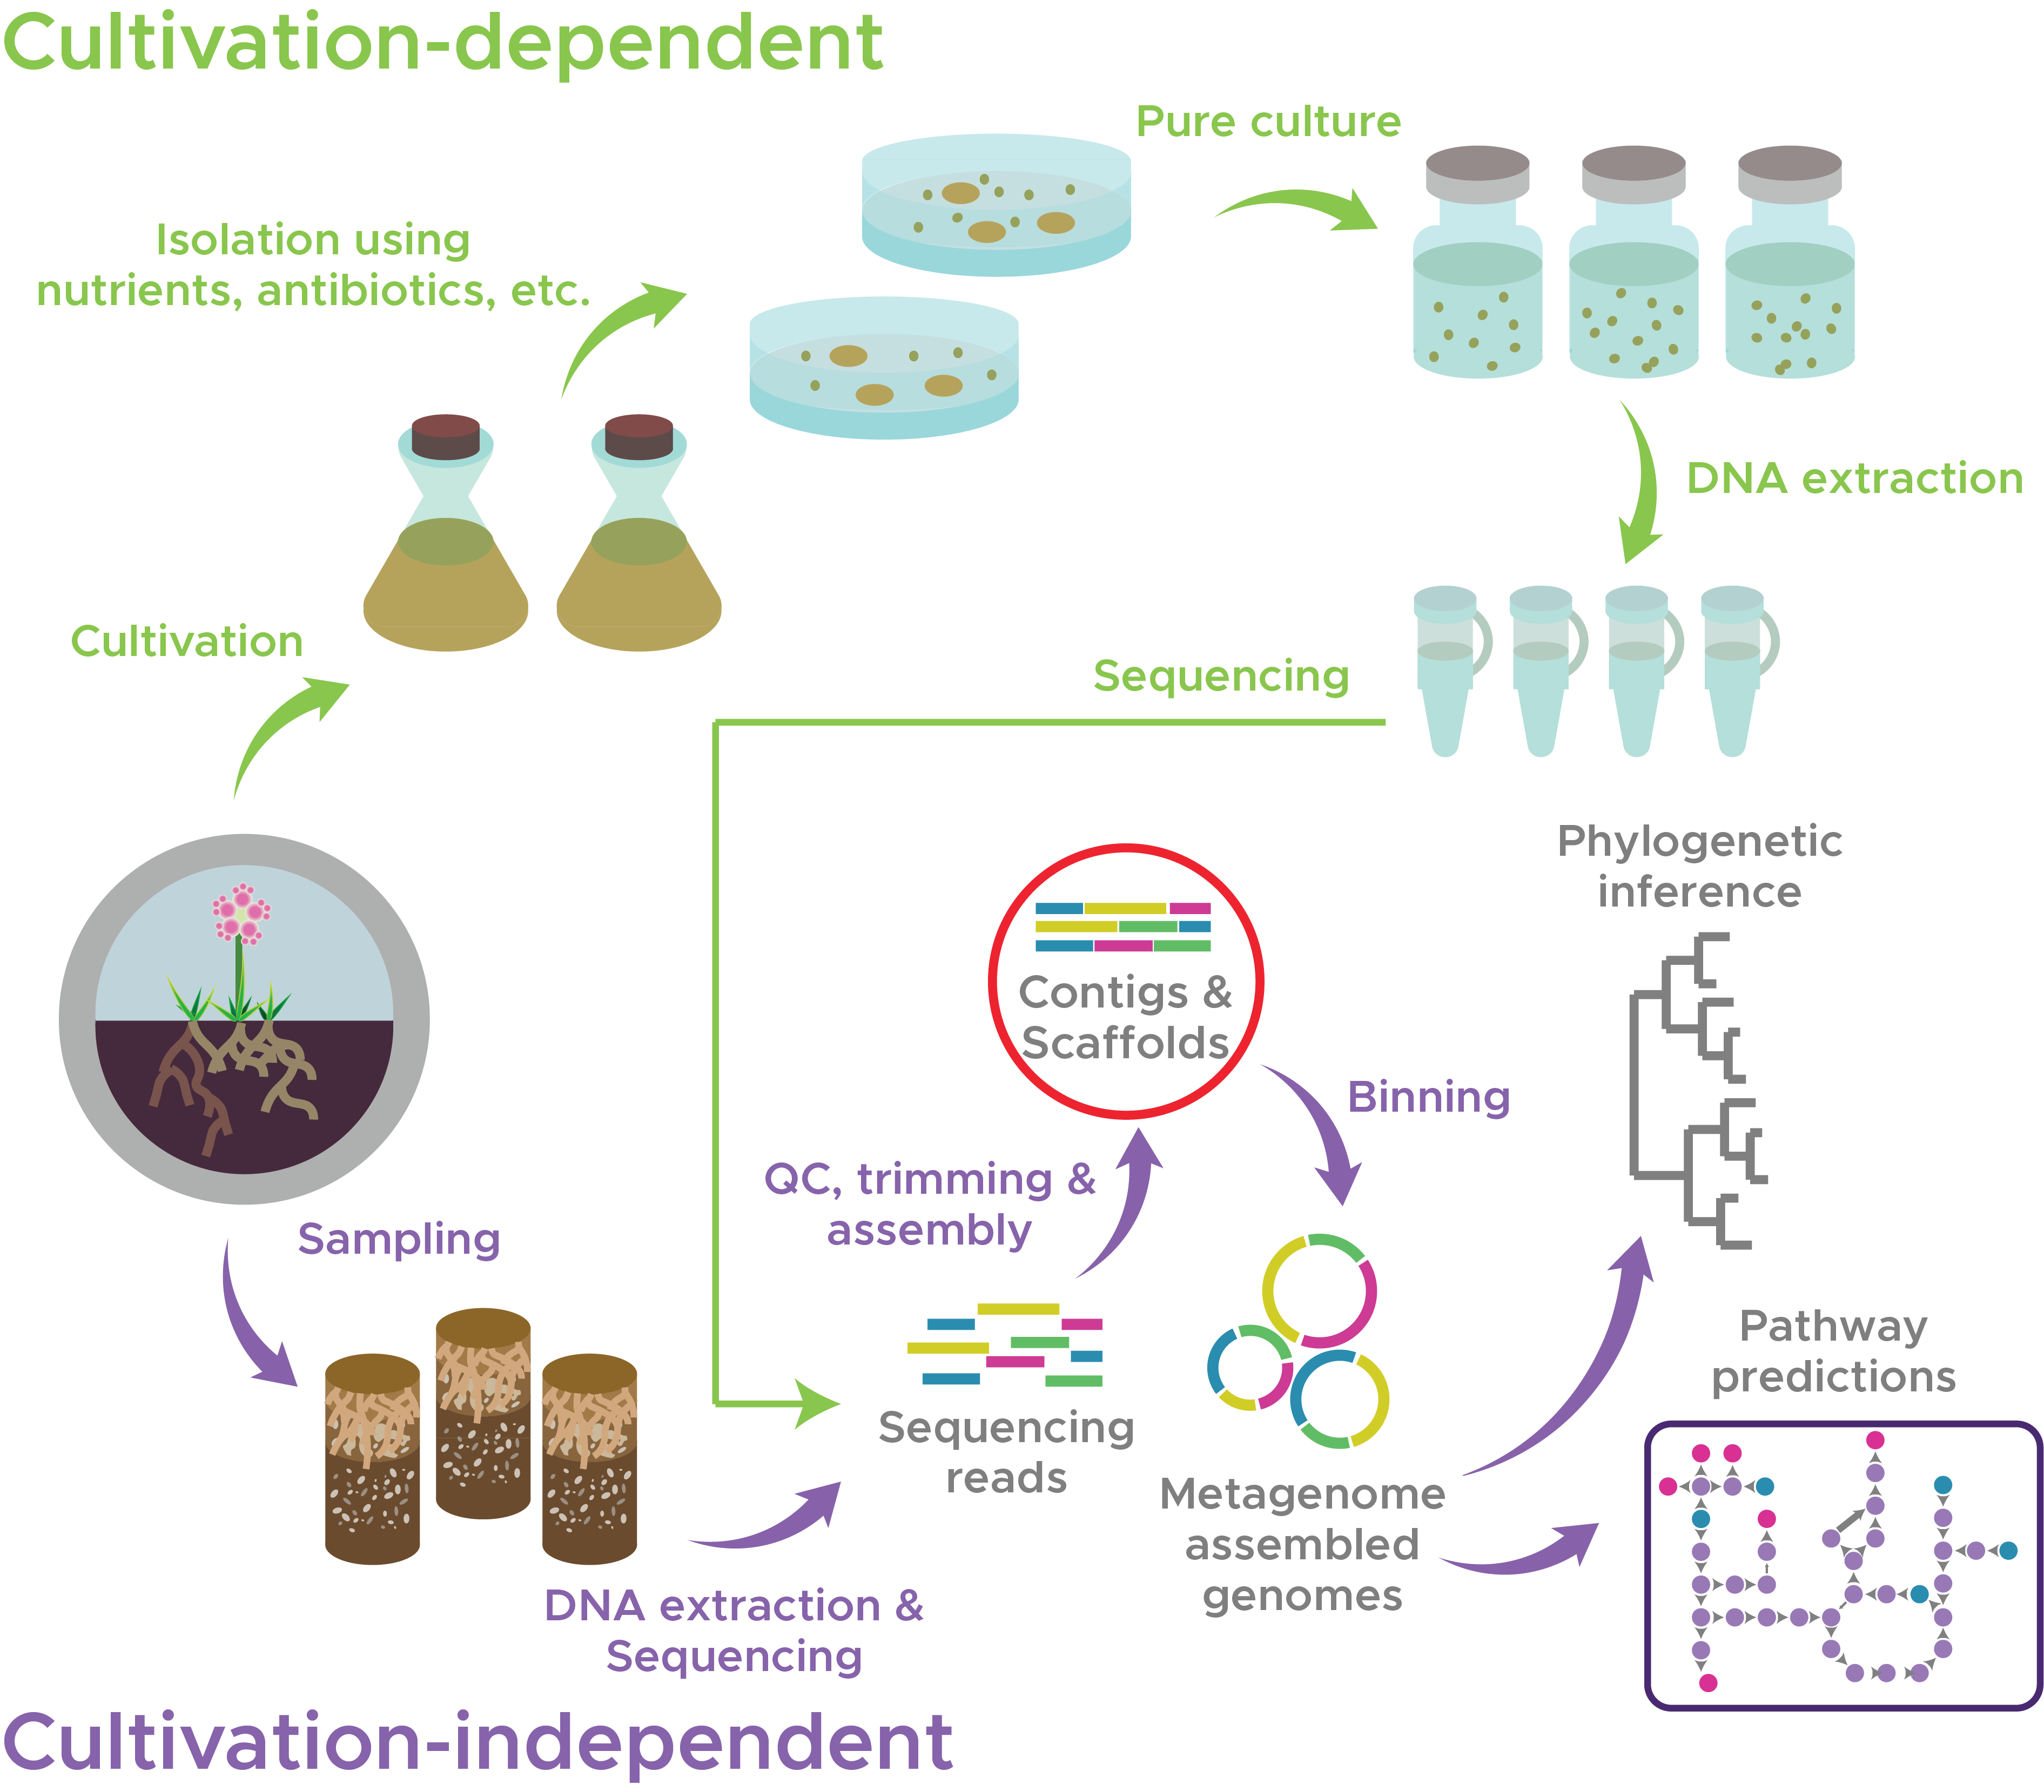
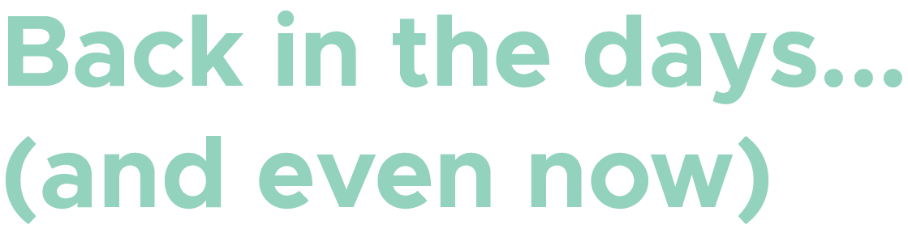
Metagenome: Collection of genetic elements (DNA) from an environment.
Metagenomics offers cultivation-independent investigation of microbial diversities & their metabolic potentials.

Slide 4

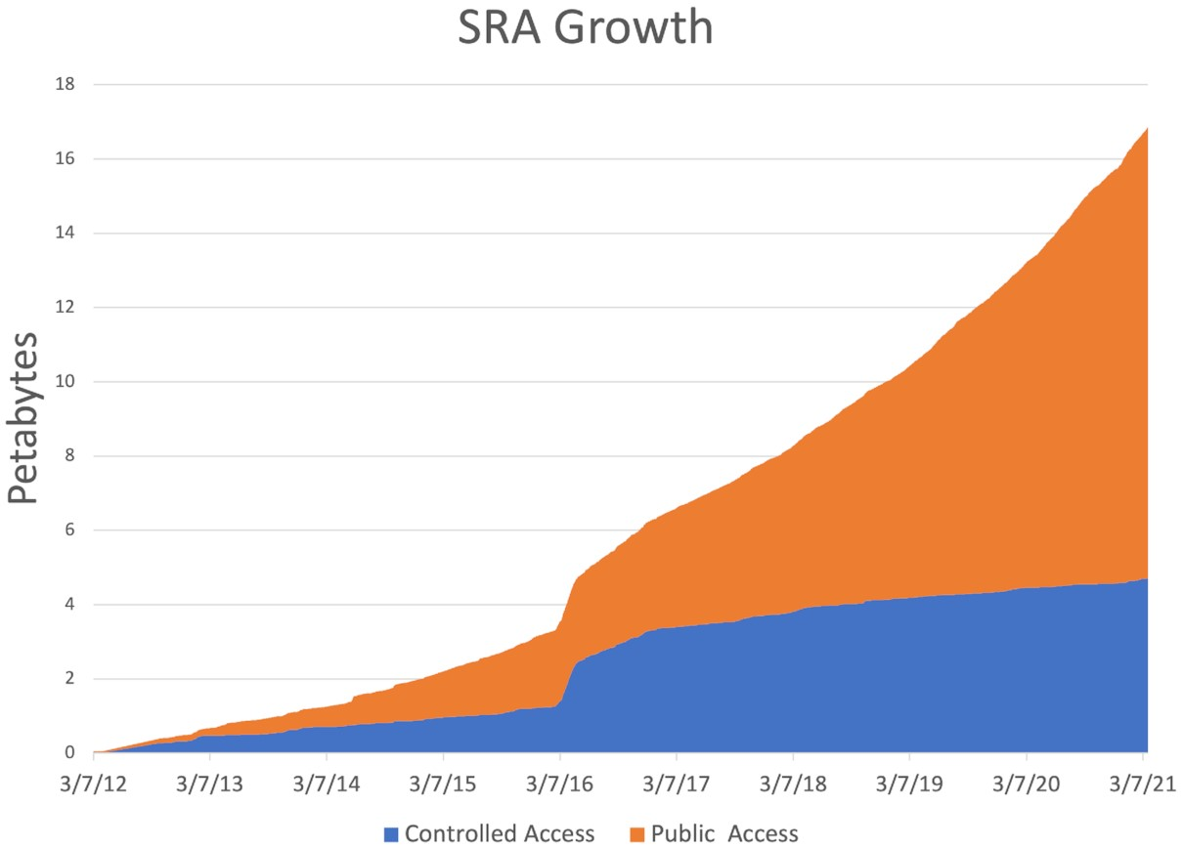
Sequencing technologies have been evolving over the years.
Generate A LOT of reads in cost-friendly manner.
More reads, more data.
Growth of DNA sequencing data in the NCBI Sequence Read Archive (SRA). Katz et al., 2022. DOI: 10.1093/nar/gkab1053

Slide 5

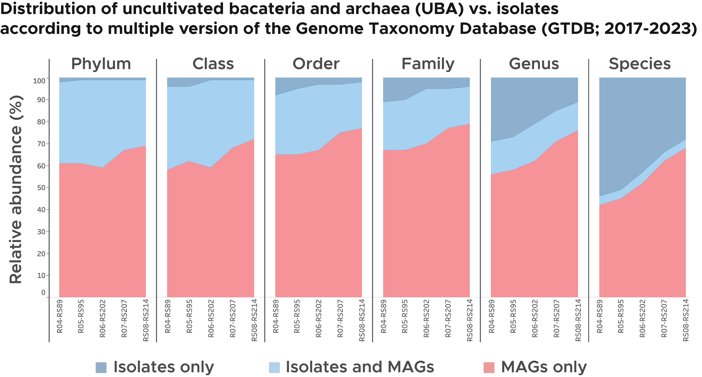
Expansion of genomic data has led to uncharted territories of the bacterial & archaeal diversities.
A shift in the trend over the years.
More clades that are composed exclusively of MAGs (or UBAs)

Slide 6
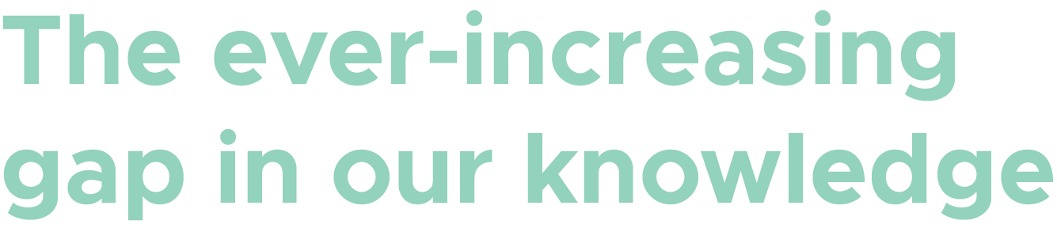
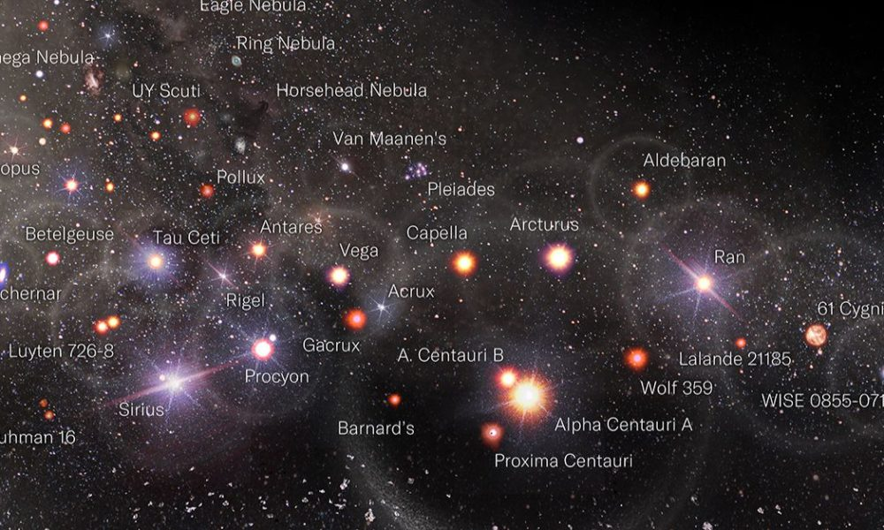
The microbial galaxy, as we see now
Most of our knowledge in microbial metabolism are derived from the “major” groups that have been studied extensively over the years.
Limited taxonomic/metabolic resolution
Need for developing novel means to cultivate wide array of microbial diversity.
The cultivated few

Slide 7
The actual microbial galaxy
Most of our knowledge in microbial metabolism are derived from the “major” groups that have been studied extensively over the years.
Limited taxonomic/metabolic resolution
Need for developing novel means to cultivate wide array of microbial diversity.
Image source: Visual Capitalist
The cultivated few

Slide 8
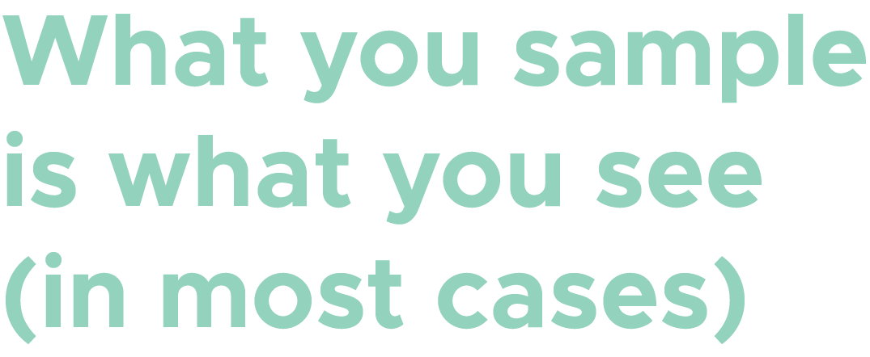
The microbial diversities observed in the metagenome data represents:
What is present in your sample and/or what was captured during the sequencing, assembly and binning processes.
And NOT:
What is present in the ecosystem from where the samples were collected.
Potential loss of MAGs (or even contigs) that represent rare species

Slide 9
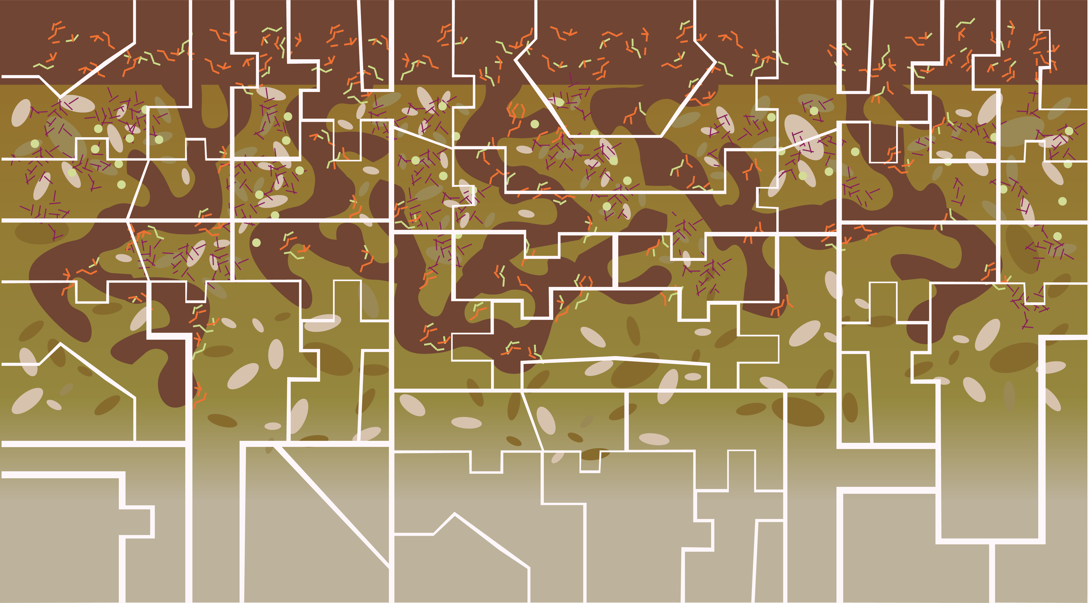
The more we sample, the more we know.
“Puzzle pieces within a puzzle piece”
Except this puzzle doesn’t have definite borders.

Slide 10

DNA extracted from soil samples submitted to the JGI.
The sequenced DNA reads are processed by the metagenomics workflow.

Slide 11
Sequencing & QC : Illumina sequenced reads are filtered to remove non-bacterial/archaeal reads and those with low-quality reads.
Assembly : Reads are put together into longer fragments (or contigs) using overlapping regions in the reads.
Short contigs (< 200 base pairs) are discarded

Slide 12
Annotation: Searches contigs against multiple databases for structural and functional features.
Structural: rRNA, tRNA, ncRNA, CRISPRs, CDS.
Functional: Genes encoding proteins involved in pathways
Contig-level annotations are good tools for assessing high-level metabolic processes in the ecosystem.

Slide 13
Read-based taxonomy : Searches the functional genes for the best hits.
Taxonomy of the best hits are assigned to the proteins.

Slide 14
Binning: contigs are mapped to reference genomes
Generates a set of “complete” set of genomes (metagenome-assembled genomes or MAGs).
Bins are used to answer questions such as:
Which species may be involved in processes, A, B, C ?
What are the metabolic potentials of species Y in relation to carbon cycling?

Slide 15
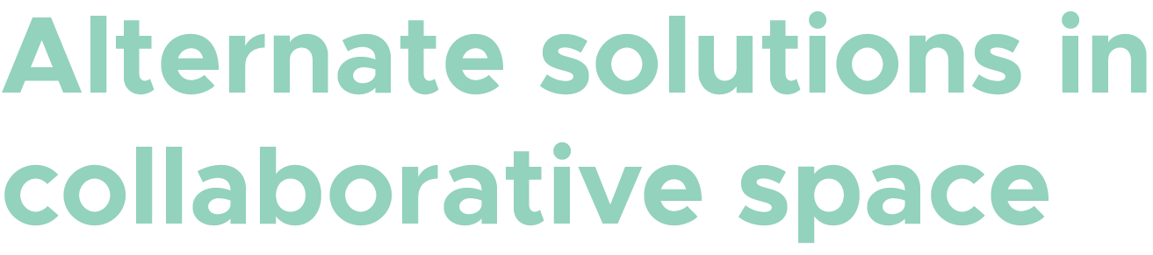
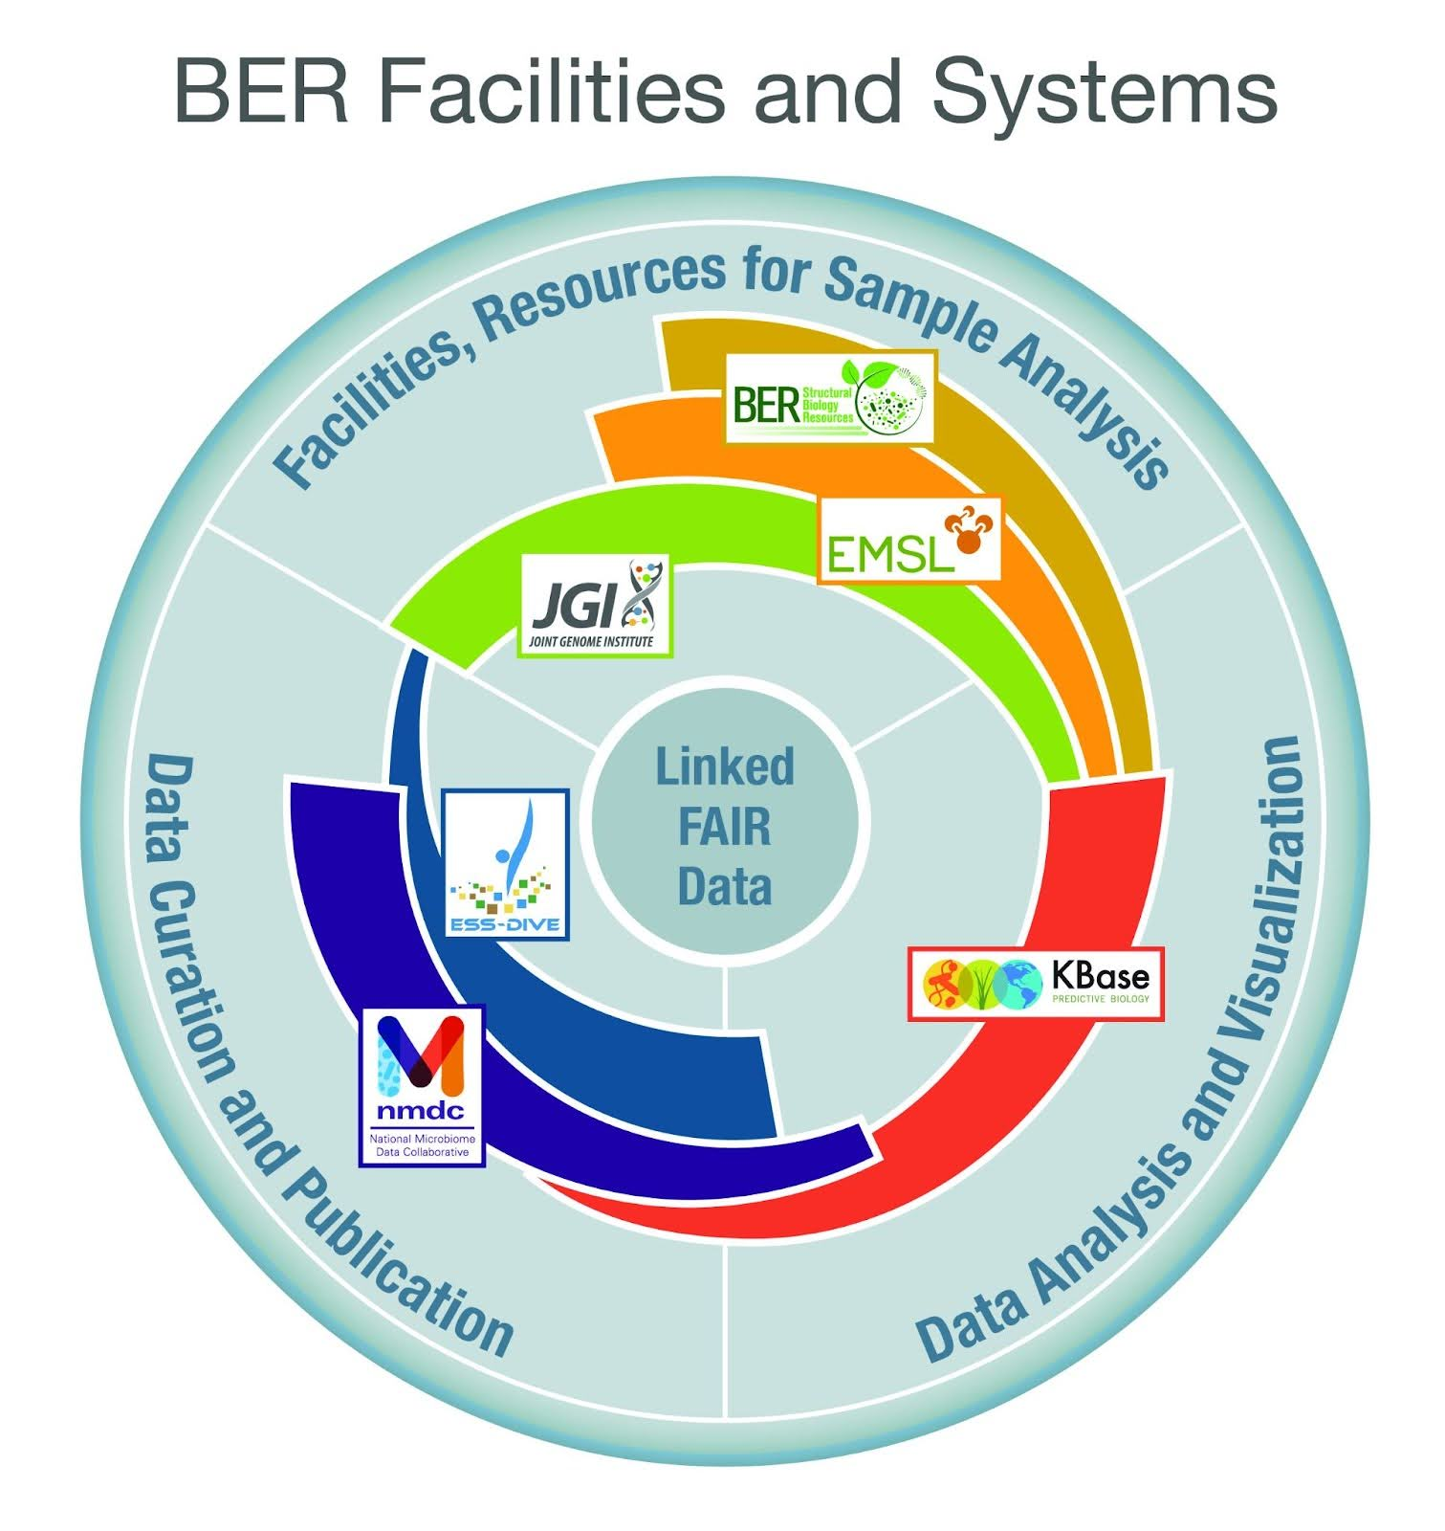
KBase: community-driven research platform for supporting collaborative data integration, analysis, and publication.
Import data from the DOE Biological and Environmental Research(BER) facilities or other sources.
Part of the DOE’s effort to create and manage data according to the FAIR (Findability, Accessibility, Interoperability, and Reusability) principles.
KBase. Source slide accessed on the 25th of October 2024

Slide 16
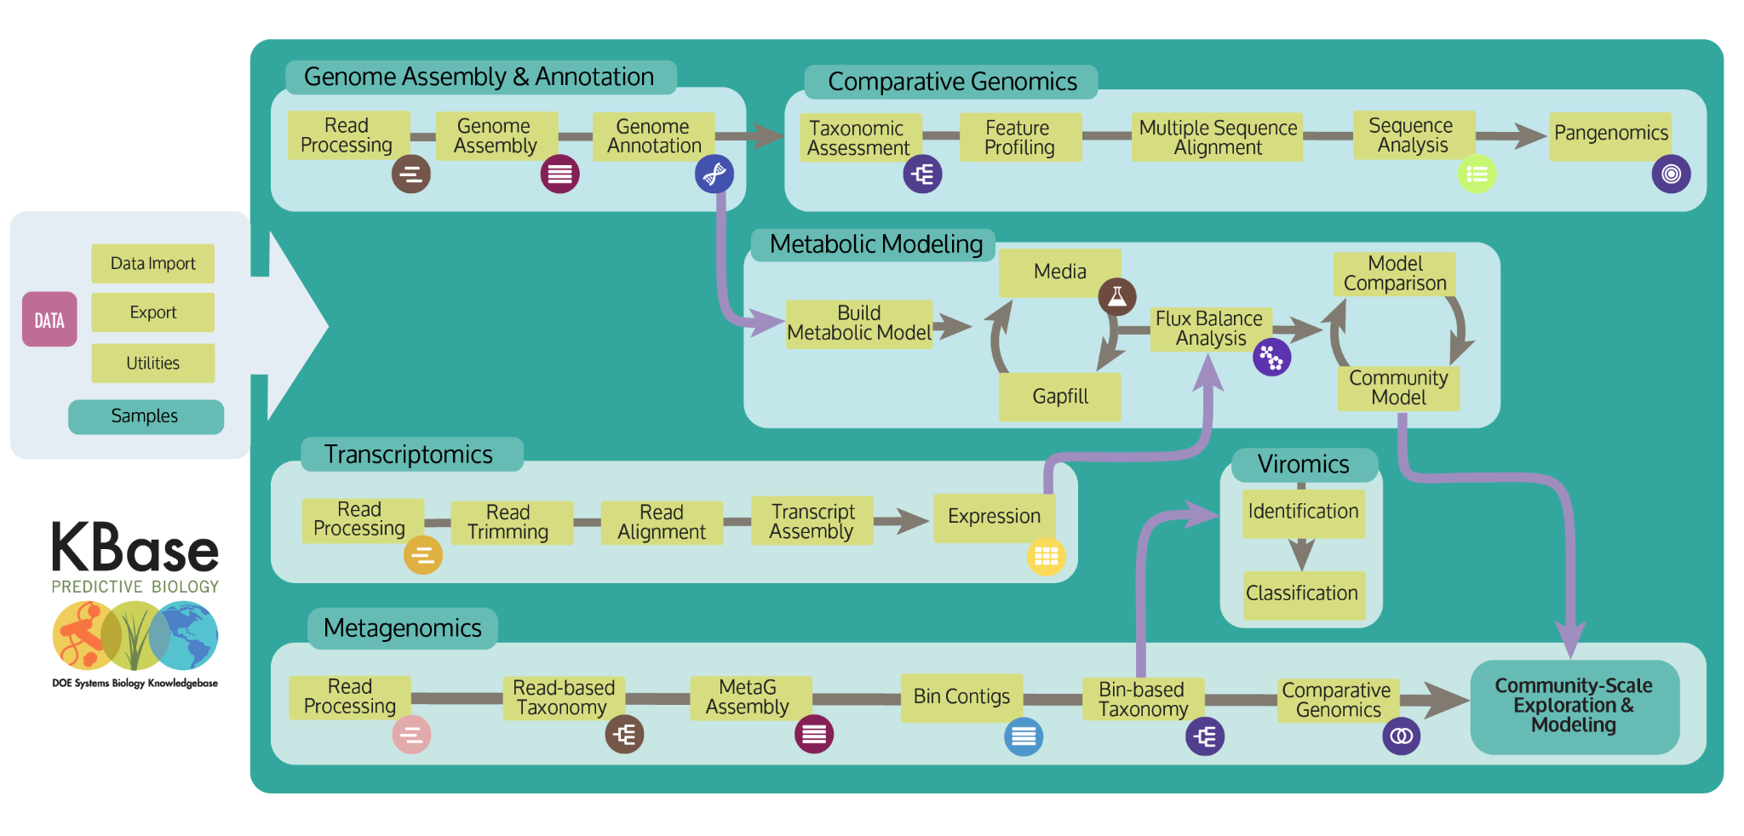
Customizable analysis, using 200+ apps organized into the multiple categories.
We will cover a test case analysis using a workflow designed using KBase.
Ideal solution in cases where analyses and curation of data are impeded by technological bottlenecks (e.g., installation, licensing, etc.)
KBase. Source slide accessed on the 25th of October 2024
Categories of apps available in KBase:
Read Processing
Metabolic Modeling
Genome Assembly
Expression
Genome Annotation
Microbial Communities
Comparative Genomics
Virus
Sequence Analysis
Utilities

Slide 17

Your suggestions/feedback are welcome.
Looking forward to collaborate with you.
young.song@pnnl.gov

